Slide 1
Algorithms: Greedy Method
Minimum Spanning Tree

Slide 2
A spanning tree is a subset of Graph G, which has all the vertices covered with minimum possible number of edges. Hence, a spanning tree does not have cycles and it cannot be disconnected.. By this definition, we can draw a conclusion that every connected and undirected Graph G has at least one spanning tree.
If there are n vertices in the graph, then each spanning tree has n − 1 edges.

Slide 3
Minimum Spanning Tree
Problem: given a connected, undirected, weighted graph:
6
4
5
9
14
2
10
15
3
8

Slide 4
Minimum Spanning Tree
Problem: given a connected, undirected, weighted graph, find a spanning tree using edges that minimize the total weight
6
4
5
9
14
2
10
15
3
8

Slide 5
helpful link
https://www.programiz.com/dsa/spanning-tree-and-minimum-spanning-tree
How many edges in a spanning tree?
Is the minimum spanning tree unique?

Slide 6
Minimum Spanning Tree
Which edges form the minimum spanning tree (MST) of the graph as shown below?
A
6
4
H
5
B
9
C
14
2
10
G
E
15
D
3
8
F

Slide 7
Minimum Spanning Tree
Answer:
A
6
4
H
5
B
9
C
14
2
10
G
E
15
D
3
8
F

Slide 8
Minimum Spanning Tree
MSTs satisfy the optimal substructure property: an optimal minimum spanning tree is composed of optimal minimum spanning subtrees
Let T be an MST of G with an edge (u, v) in the middle
Removing (u, v) partitions T into two trees T₁ and T₂
Claim: T₁ is an MST of G₁ = (V₁,E₁), and T₂ is an MST of G₂ = (V₂,E₂) (Do V₁ and V₂ share vertices? Why?)
Proof: w(T) = w(u,v) + w(T₁) + w(T₂) (There can’t be a better tree than T₁ or T₂. Then T would be suboptimal)
6
4
5
9
14
2
10
15
3
8

Slide 9
Prim’s Algorithm
MST-Prim(G, w, r)
Q = V[G];
for each u ∈ Q
key[u] = ∞;
key[r] = 0;
p[r] = NULL;
while (Q not empty)
u = ExtractMin(Q);
for each v ∈ Adj[u]
if (v ∈ Q and w(u,v) < key[v])
p[v] = u;
key[v] = w(u,v);

Slide 10
Prim’s Algorithm
MST-Prim(G, w, r)
Q = V[G];
for each u ∈ Q
key[u] = ∞;
key[r] = 0;
p[r] = NULL;
while (Q not empty)
u = ExtractMin(Q);
for each v ∈ Adj[u]
if (v ∈ Q and w(u,v) < key[v])
p[v] = u;
key[v] = w(u,v);
6
4
5
9
14
2
10
15
3
8
Run on example graph

Slide 11
Prim’s Algorithm
MST-Prim(G, w, r)
Q = V[G];
for each u ∈ Q
key[u] = ∞;
key[r] = 0;
p[r] = NULL;
while (Q not empty)
u = ExtractMin(Q);
for each v ∈ Adj[u]
if (v ∈ Q and w(u,v) < key[v])
p[v] = u;
key[v] = w(u,v);
6
∞
4
5
9
∞
∞
∞
14
2
10
15
∞
∞
∞
3
∞
8
Run on example graph

Slide 12
Prim’s Algorithm
MST-Prim(G, w, r)
Q = V[G];
for each u ∈ Q
key[u] = ∞;
key[r] = 0;
p[r] = NULL;
while (Q not empty)
u = ExtractMin(Q);
for each v ∈ Adj[u]
if (v ∈ Q and w(u,v) < key[v])
p[v] = u;
key[v] = w(u,v);
6
∞
4
5
9
∞
∞
∞
14
2
10
15
r
0
∞
∞
3
∞
8
Pick a start vertex r

Slide 13
Prim’s Algorithm
MST-Prim(G, w, r)
Q = V[G];
for each u ∈ Q
key[u] = ∞;
key[r] = 0;
p[r] = NULL;
while (Q not empty)
u = ExtractMin(Q);
for each v ∈ Adj[u]
if (v ∈ Q and w(u,v) < key[v])
p[v] = u;
key[v] = w(u,v);
6
∞
4
5
9
∞
∞
∞
14
2
10
15
u
0
∞
∞
3
∞
8
Red vertices have been removed from Q

Slide 14
Prim’s Algorithm
MST-Prim(G, w, r)
Q = V[G];
for each u ∈ Q
key[u] = ∞;
key[r] = 0;
p[r] = NULL;
while (Q not empty)
u = ExtractMin(Q);
for each v ∈ Adj[u]
if (v ∈ Q and w(u,v) < key[v])
p[v] = u;
key[v] = w(u,v);
6
∞
4
5
9
∞
∞
∞
14
2
10
15
u
0
∞
∞
3
3
8
Red arrows indicate parent pointers

Slide 15
Prim’s Algorithm
MST-Prim(G, w, r)
Q = V[G];
for each u ∈ Q
key[u] = ∞;
key[r] = 0;
p[r] = NULL;
while (Q not empty)
u = ExtractMin(Q);
for each v ∈ Adj[u]
if (v ∈ Q and w(u,v) < key[v])
p[v] = u;
key[v] = w(u,v);
6
∞
4
5
9
14
∞
∞
14
2
10
15
u
0
∞
∞
3
3
8

Slide 16
Prim’s Algorithm
MST-Prim(G, w, r)
Q = V[G];
for each u ∈ Q
key[u] = ∞;
key[r] = 0;
p[r] = NULL;
while (Q not empty)
u = ExtractMin(Q);
for each v ∈ Adj[u]
if (v ∈ Q and w(u,v) < key[v])
p[v] = u;
key[v] = w(u,v);
6
∞
4
5
9
14
∞
∞
14
2
10
15
0
∞
∞
3
3
8
u

Slide 17
Prim’s Algorithm
MST-Prim(G, w, r)
Q = V[G];
for each u ∈ Q
key[u] = ∞;
key[r] = 0;
p[r] = NULL;
while (Q not empty)
u = ExtractMin(Q);
for each v ∈ Adj[u]
if (v ∈ Q and w(u,v) < key[v])
p[v] = u;
key[v] = w(u,v);
6
∞
4
5
9
14
∞
∞
14
2
10
15
0
8
∞
3
3
8
u

Slide 18
Prim’s Algorithm
MST-Prim(G, w, r)
Q = V[G];
for each u ∈ Q
key[u] = ∞;
key[r] = 0;
p[r] = NULL;
while (Q not empty)
u = ExtractMin(Q);
for each v ∈ Adj[u]
if (v ∈ Q and w(u,v) < key[v])
p[v] = u;
key[v] = w(u,v);
6
∞
4
5
9
10
∞
∞
14
2
10
15
0
8
∞
3
3
8
u

Slide 19
Prim’s Algorithm
MST-Prim(G, w, r)
Q = V[G];
for each u ∈ Q
key[u] = ∞;
key[r] = 0;
p[r] = NULL;
while (Q not empty)
u = ExtractMin(Q);
for each v ∈ Adj[u]
if (v ∈ Q and w(u,v) < key[v])
p[v] = u;
key[v] = w(u,v);
6
∞
4
5
9
10
∞
∞
14
2
10
15
0
8
∞
3
3
8
u

Slide 20
Prim’s Algorithm
MST-Prim(G, w, r)
Q = V[G];
for each u ∈ Q
key[u] = ∞;
key[r] = 0;
p[r] = NULL;
while (Q not empty)
u = ExtractMin(Q);
for each v ∈ Adj[u]
if (v ∈ Q and w(u,v) < key[v])
p[v] = u;
key[v] = w(u,v);
6
∞
4
5
9
10
2
∞
14
2
10
15
0
8
∞
3
3
8
u

Slide 21
Prim’s Algorithm
MST-Prim(G, w, r)
Q = V[G];
for each u ∈ Q
key[u] = ∞;
key[r] = 0;
p[r] = NULL;
while (Q not empty)
u = ExtractMin(Q);
for each v ∈ Adj[u]
if (v ∈ Q and w(u,v) < key[v])
p[v] = u;
key[v] = w(u,v);
6
∞
4
5
9
10
2
∞
14
2
10
15
0
8
15
3
3
8
u

Slide 22
Prim’s Algorithm
u
MST-Prim(G, w, r)
Q = V[G];
for each u ∈ Q
key[u] = ∞;
key[r] = 0;
p[r] = NULL;
while (Q not empty)
u = ExtractMin(Q);
for each v ∈ Adj[u]
if (v ∈ Q and w(u,v) < key[v])
p[v] = u;
key[v] = w(u,v);
6
∞
4
5
9
10
2
∞
14
2
10
15
0
8
15
3
3
8

Slide 23
Prim’s Algorithm
u
MST-Prim(G, w, r)
Q = V[G];
for each u ∈ Q
key[u] = ∞;
key[r] = 0;
p[r] = NULL;
while (Q not empty)
u = ExtractMin(Q);
for each v ∈ Adj[u]
if (v ∈ Q and w(u,v) < key[v])
p[v] = u;
key[v] = w(u,v);
6
∞
4
5
9
10
2
9
14
2
10
15
0
8
15
3
3
8

Slide 24
Prim’s Algorithm
u
MST-Prim(G, w, r)
Q = V[G];
for each u ∈ Q
key[u] = ∞;
key[r] = 0;
p[r] = NULL;
while (Q not empty)
u = ExtractMin(Q);
for each v ∈ Adj[u]
if (v ∈ Q and w(u,v) < key[v])
p[v] = u;
key[v] = w(u,v);
6
4
4
5
9
10
2
9
14
2
10
15
0
8
15
3
3
8

Slide 25
Prim’s Algorithm
u
MST-Prim(G, w, r)
Q = V[G];
for each u ∈ Q
key[u] = ∞;
key[r] = 0;
p[r] = NULL;
while (Q not empty)
u = ExtractMin(Q);
for each v ∈ Adj[u]
if (v ∈ Q and w(u,v) < key[v])
p[v] = u;
key[v] = w(u,v);
6
4
4
5
9
5
2
9
14
2
10
15
0
8
15
3
3
8

Slide 26
Prim’s Algorithm
u
MST-Prim(G, w, r)
Q = V[G];
for each u ∈ Q
key[u] = ∞;
key[r] = 0;
p[r] = NULL;
while (Q not empty)
u = ExtractMin(Q);
for each v ∈ Adj[u]
if (v ∈ Q and w(u,v) < key[v])
p[v] = u;
key[v] = w(u,v);
6
4
4
5
9
5
2
9
14
2
10
15
0
8
15
3
3
8

Slide 27
Prim’s Algorithm
u
MST-Prim(G, w, r)
Q = V[G];
for each u ∈ Q
key[u] = ∞;
key[r] = 0;
p[r] = NULL;
while (Q not empty)
u = ExtractMin(Q);
for each v ∈ Adj[u]
if (v ∈ Q and w(u,v) < key[v])
p[v] = u;
key[v] = w(u,v);
6
4
4
5
9
5
2
9
14
2
10
15
0
8
15
3
3
8

Slide 28
Prim’s Algorithm
u
MST-Prim(G, w, r)
Q = V[G];
for each u ∈ Q
key[u] = ∞;
key[r] = 0;
p[r] = NULL;
while (Q not empty)
u = ExtractMin(Q);
for each v ∈ Adj[u]
if (v ∈ Q and w(u,v) < key[v])
p[v] = u;
key[v] = w(u,v);
6
4
4
5
9
5
2
9
14
2
10
15
0
8
15
3
3
8

Slide 29
Prim’s Algorithm
MST-Prim(G, w, r)
Q = V[G];
for each u ∈ Q
key[u] = ∞;
key[r] = 0;
p[r] = NULL;
while (Q not empty)
u = ExtractMin(Q);
for each v ∈ Adj[u]
if (v ∈ Q and w(u,v) < key[v])
p[v] = u;
key[v] = w(u,v);
6
4
4
5
9
5
2
9
14
2
u
10
15
0
8
15
3
3
8

Slide 30
Review: Prim’s Algorithm
MST-Prim(G, w, r)
Q = V[G];
for each u ∈ Q
key[u] = ∞;
key[r] = 0;
p[r] = NULL;
while (Q not empty)
u = ExtractMin(Q);
for each v ∈ Adj[u]
if (v ∈ Q and w(u,v) < key[v])
p[v] = u;
key[v] = w(u,v);
What is the hidden cost in this code?

Slide 31
Review: Prim’s Algorithm
MST-Prim(G, w, r)
Q = V[G];
for each u ∈ Q
key[u] = ∞;
key[r] = 0;
p[r] = NULL;
while (Q not empty)
u = ExtractMin(Q);
for each v ∈ Adj[u]
if (v ∈ Q and w(u,v) < key[v])
p[v] = u;
DecreaseKey(v, w(u,v));

Slide 32
Review: Prim’s Algorithm
MST-Prim(G, w, r)
Q = V[G];
for each u ∈ Q
key[u] = ∞;
key[r] = 0;
p[r] = NULL;
while (Q not empty)
u = ExtractMin(Q);
for each v ∈ Adj[u]
if (v ∈ Q and w(u,v) < key[v])
p[v] = u;
DecreaseKey(v, w(u,v));
How often is ExtractMin() called?
How often is DecreaseKey() called?

Slide 33
Review: Prim’s Algorithm
MST-Prim(G, w, r)
Q = V[G];
for each u ∈ Q
key[u] = ∞;
key[r] = 0;
p[r] = NULL;
while (Q not empty)
u = ExtractMin(Q);
for each v ∈ Adj[u]
if (v ∈ Q and w(u,v) < key[v])
p[v] = u;
key[v] = w(u,v);
What will be the running time? A: Depends on queue binary heap: O(E lg V) Fibonacci heap: O(V lg V + E)

Slide 34
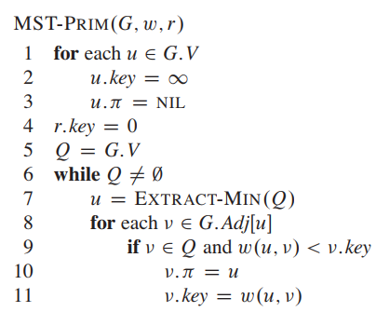
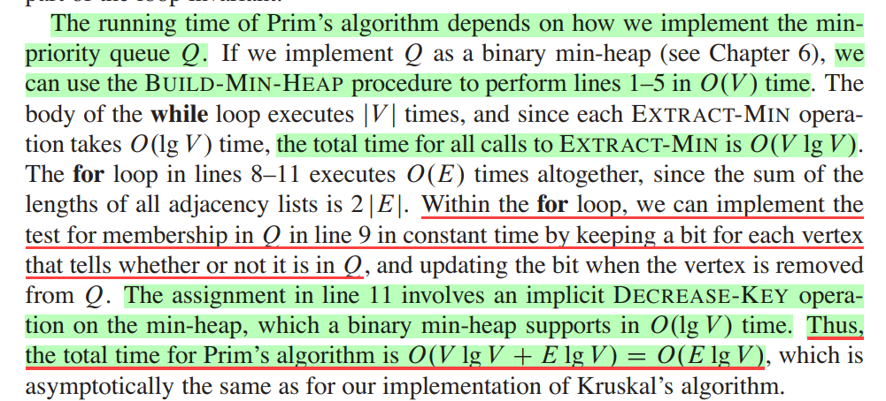
Cormen 23

Slide 35
Prim's algorithm is very similar to Kruskal's: whereas Kruskal's "grows" a forest of trees, Prim's algorithm grows a single tree until it becomes the minimum spanning tree. Both algorithms use the greedy approach - they add the cheapest edge that will not cause a cycle. But rather than choosing the cheapest edge that will connect any pair of trees together, Prim's algorithm only adds edges that join nodes to the existing tree. (In this respect, Prim's algorithm is very similar to Dijkstra's algorithm for finding shortest paths.)
https://www.cs.auckland.ac.nz/software/AlgAnim/prim.html

Slide 36
Disjoint-Set Union Problem
Want a data structure to support disjoint sets
Collection of disjoint sets S = U_{i} {S_{i}}, S_{i} ∩ S_{j} = ∅
Need to support following operations:
MakeSet(x): S = S U {{x}}
Union(S_{i}, S_{j}): S = S - {S_{i}, S_{j}} U {S_{i} U S_{j}}
FindSet(x): return S_{i} ∈ S such that x ∈ S_{i}
Before discussing implementation details, we look at example application: MSTs

Slide 37
Kruskal’s Algorithm
Kruskal()
{
T = ∅;
for each v ∈ V
MakeSet(v);
sort E into nondecreasing order by weight w
for each (u,v) ∈ E (in sorted order)
if FindSet(u) ≠ FindSet(v)
T = T U {{u,v}};
Union(u,v);
}

Slide 38
Kruskal’s Algorithm
2
19
Kruskal()
{
T = ∅;
for each v ∈ V
MakeSet(v);
sort E into nondecreasing order by weight w
for each (u,v) ∈ E (in sorted order)
if FindSet(u) ≠ FindSet(v)
T = T U {{u,v}};
Union(u,v);
}
9
14
17
8
25
5
21
13
1

Slide 39
Kruskal’s Algorithm
2
19
Kruskal()
{
T = ∅;
for each v ∈ V
MakeSet(v);
sort E into nondecreasing order by weight w
for each (u,v) ∈ E (in sorted order)
if FindSet(u) ≠ FindSet(v)
T = T U {{u,v}};
Union(u,v);
}
9
14
17
8
25
5
21
13
1

Slide 40
Kruskal’s Algorithm
2
19
Kruskal()
{
T = ∅;
for each v ∈ V
MakeSet(v);
sort E into nondecreasing order by weight w
for each (u,v) ∈ E (in sorted order)
if FindSet(u) ≠ FindSet(v)
T = T U {{u,v}};
Union(u,v);
}
9
14
17
8
25
5
21
13
1

Slide 41
Kruskal’s Algorithm
2
19
Kruskal()
{
T = ∅;
for each v ∈ V
MakeSet(v);
sort E into nondecreasing order by weight w
for each (u,v) ∈ E (in sorted order)
if FindSet(u) ≠ FindSet(v)
T = T U {{u,v}};
Union(u,v);
}
9
14
17
8
25
5
21
13
1?

Slide 42
Kruskal’s Algorithm
2
19
Kruskal()
{
T = ∅;
for each v ∈ V
MakeSet(v);
sort E into nondecreasing order by weight w
for each (u,v) ∈ E (in sorted order)
if FindSet(u) ≠ FindSet(v)
T = T U {{u,v}};
Union(u,v);
}
9
14
17
8
25
5
21
13
1

Slide 43
Kruskal’s Algorithm
2?
19
Kruskal()
{
T = ∅;
for each v ∈ V
MakeSet(v);
sort E into nondecreasing order by weight w
for each (u,v) ∈ E (in sorted order)
if FindSet(u) ≠ FindSet(v)
T = T U {{u,v}};
Union(u,v);
}
9
14
17
8
25
5
21
13
1

Slide 44
Kruskal’s Algorithm
2
19
Kruskal()
{
T = ∅;
for each v ∈ V
MakeSet(v);
sort E into nondecreasing order by weight w
for each (u,v) ∈ E (in sorted order)
if FindSet(u) ≠ FindSet(v)
T = T U {{u,v}};
Union(u,v);
}
9
14
17
8
25
5
21
13
1

Slide 45
Kruskal’s Algorithm
2
19
Kruskal()
{
T = ∅;
for each v ∈ V
MakeSet(v);
sort E into nondecreasing order by weight w
for each (u,v) ∈ E (in sorted order)
if FindSet(u) ≠ FindSet(v)
T = T U {{u,v}};
Union(u,v);
}
9
14
17
8
25
5?
21
13
1

Slide 46
Kruskal’s Algorithm
2
19
Kruskal()
{
T = ∅;
for each v ∈ V
MakeSet(v);
sort E into nondecreasing order by weight w
for each (u,v) ∈ E (in sorted order)
if FindSet(u) ≠ FindSet(v)
T = T U {{u,v}};
Union(u,v);
}
9
14
17
8
25
5
21
13
1

Slide 47
Kruskal’s Algorithm
2
19
Kruskal()
{
T = ∅;
for each v ∈ V
MakeSet(v);
sort E into nondecreasing order by weight w
for each (u,v) ∈ E (in sorted order)
if FindSet(u) ≠ FindSet(v)
T = T U {{u,v}};
Union(u,v);
}
9
14
17
8?
25
5
21
13
1

Slide 48
Kruskal’s Algorithm
2
19
Kruskal()
{
T = ∅;
for each v ∈ V
MakeSet(v);
sort E into nondecreasing order by weight w
for each (u,v) ∈ E (in sorted order)
if FindSet(u) ≠ FindSet(v)
T = T U {{u,v}};
Union(u,v);
}
9
14
17
8
25
5
21
13
1

Slide 49
Kruskal’s Algorithm
2
19
Kruskal()
{
T = ∅;
for each v ∈ V
MakeSet(v);
sort E into nondecreasing order by weight w
for each (u,v) ∈ E (in sorted order)
if FindSet(u) ≠ FindSet(v)
T = T U {{u,v}};
Union(u,v);
}
9?
14
17
8
25
5
21
13
1

Slide 50
Kruskal’s Algorithm
2
19
Kruskal()
{
T = ∅;
for each v ∈ V
MakeSet(v);
sort E into nondecreasing order by weight w
for each (u,v) ∈ E (in sorted order)
if FindSet(u) ≠ FindSet(v)
T = T U {{u,v}};
Union(u,v);
}
9
14
17
8
25
5
21
13
1

Slide 51
Kruskal’s Algorithm
2
19
Kruskal()
{
T = ∅;
for each v ∈ V
MakeSet(v);
sort E into nondecreasing order by weight w
for each (u,v) ∈ E (in sorted order)
if FindSet(u) ≠ FindSet(v)
T = T U {{u,v}};
Union(u,v);
}
9
14
17
8
25
5
21
13?
1

Slide 52
Kruskal’s Algorithm
2
19
Kruskal()
{
T = ∅;
for each v ∈ V
MakeSet(v);
sort E into nondecreasing order by weight w
for each (u,v) ∈ E (in sorted order)
if FindSet(u) ≠ FindSet(v)
T = T U {{u,v}};
Union(u,v);
}
9
14
17
8
25
5
21
13
1

Slide 53
Kruskal’s Algorithm
2
19
Kruskal()
{
T = ∅;
for each v ∈ V
MakeSet(v);
sort E into nondecreasing order by weight w
for each (u,v) ∈ E (in sorted order)
if FindSet(u) ≠ FindSet(v)
T = T U {{u,v}};
Union(u,v);
}
9
14?
17
8
25
5
21
13
1

Slide 54
Kruskal’s Algorithm
2
19
Kruskal()
{
T = ∅;
for each v ∈ V
MakeSet(v);
sort E into nondecreasing order by weight w
for each (u,v) ∈ E (in sorted order)
if FindSet(u) ≠ FindSet(v)
T = T U {{u,v}};
Union(u,v);
}
9
14
17
8
25
5
21
13
1

Slide 55
Kruskal’s Algorithm
2
19
Kruskal()
{
T = ∅;
for each v ∈ V
MakeSet(v);
sort E into nondecreasing order by weight w
for each (u,v) ∈ E (in sorted order)
if FindSet(u) ≠ FindSet(v)
T = T U {{u,v}};
Union(u,v);
}
9
14
17?
8
25
5
21
13
1

Slide 56
Kruskal’s Algorithm
2
19?
Kruskal()
{
T = ∅;
for each v ∈ V
MakeSet(v);
sort E into nondecreasing order by weight w
for each (u,v) ∈ E (in sorted order)
if FindSet(u) ≠ FindSet(v)
T = T U {{u,v}};
Union(u,v);
}
9
14
17
8
25
5
21
13
1

Slide 57
Kruskal’s Algorithm
2
19
Kruskal()
{
T = ∅;
for each v ∈ V
MakeSet(v);
sort E into nondecreasing order by weight w
for each (u,v) ∈ E (in sorted order)
if FindSet(u) ≠ FindSet(v)
T = T U {{u,v}};
Union(u,v);
}
9
14
17
8
25
5
21?
13
1

Slide 58
Kruskal’s Algorithm
2
19
Kruskal()
{
T = ∅;
for each v ∈ V
MakeSet(v);
sort E into nondecreasing order by weight w
for each (u,v) ∈ E (in sorted order)
if FindSet(u) ≠ FindSet(v)
T = T U {{u,v}};
Union(u,v);
}
9
14
17
8
25?
5
21
13
1

Slide 59
Kruskal’s Algorithm
2
19
Kruskal()
{
T = ∅;
for each v ∈ V
MakeSet(v);
sort E into nondecreasing order by weight w
for each (u,v) ∈ E (in sorted order)
if FindSet(u) ≠ FindSet(v)
T = T U {{u,v}};
Union(u,v);
}
9
14
17
8
25
5
21
13
1

Slide 60
Kruskal’s Algorithm
2
19
Kruskal()
{
T = ∅;
for each v ∈ V
MakeSet(v);
sort E into nondecreasing order by weight w
for each (u,v) ∈ E (in sorted order)
if FindSet(u) ≠ FindSet(v)
T = T U {{u,v}};
Union(u,v);
}
9
14
17
8
25
5
21
13
1

Slide 61
Kruskal’s Algorithm: Running Time
What will affect the running time?
Kruskal()
{
T = ∅;
for each v ∈ V
MakeSet(v);
sort E by increasing edge weight w
for each (u,v) ∈ E (in sorted order)
if FindSet(u) ≠ FindSet(v)
T = T U {{u,v}};
Union(u,v);
}

Slide 62
Kruskal’s Algorithm: Running Time
What will affect the running time?
1 Sort
O(V) MakeSet() calls
O(E) FindSet() calls O(V) Union() calls
(Exactly how many Union()s?)
Kruskal()
{
T = ∅;
for each v ∈ V
MakeSet(v);
sort E by increasing edge weight w
for each (u,v) ∈ E (in sorted order)
if FindSet(u) ≠ FindSet(v)
T = T U {{u,v}};
Union(u,v);
}

Slide 63
Kruskal’s Algorithm: Running Time
To summarize:
Sort edges: O(E lg E)
O(V) MakeSet()’s
O(E) FindSet()’s
O(V) Union()’s
Upshot:
Best disjoint-set operation algorithm makes above three operations to take O(E lg E) time.
Thus overall time is O(E lg E) = O(E lg V), since |E| < |V|²

Slide 64
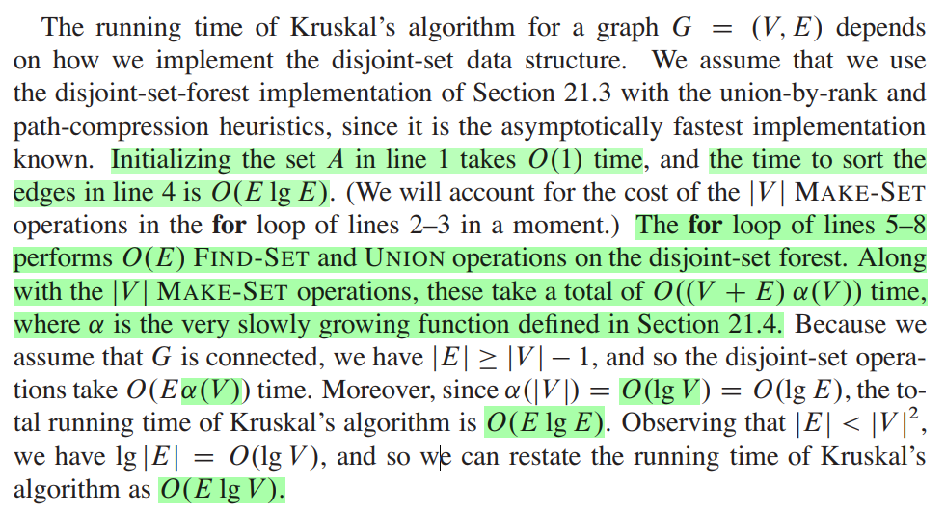
Kruskal’s Algorithm: Running Time
To summarize:
Sort edges: O(E lg E)
O(V) MakeSet()’s
O(E) FindSet()’s
O(V) Union()’s
Cormen 23.2

Slide 65
How can you find the second best minimum spanning tree?
https://cp-algorithms.com/graph/second_best_mst.html
Draw a minimum spanning tree of the given graph G such that the minimum spanning tree always consists the edges with weights x and z.
Assign weights to each of the edges such that the MST of this graph consists exactly of the edges …
Kruskal’s algorithm may provide different Minimum Spanning Trees (MST) based on how it sorts the edge-list of the graph. Provide an example of a graph where the Kruskal’s algorithm will return two different MSTs on two different runs of the algorithm, based on the edge-list being sorted differently.
Analyze the running time of the algorithm.

